Slide 1




Astronomy 1010 chapter 10
Clayton State University
Slides for Astronomy textbook from OpenStax
https://openstax.org/books/astronomy/

Slide 2
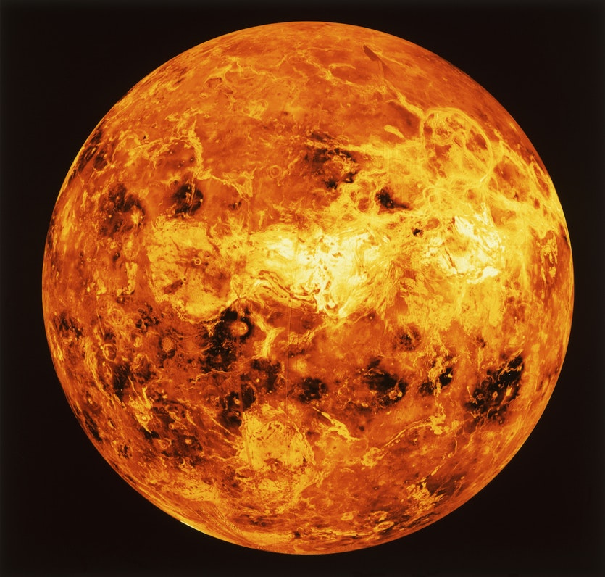
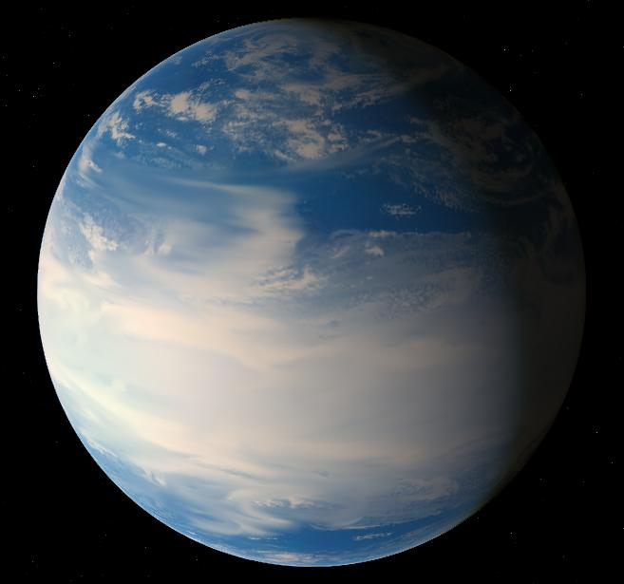
Inner planets: Venus
Satellites
  None
Mean radius
  0.9499 of Earth
Surface area
  0.902 of Earth
Volume
  0.866 of Earth
Mass
  0.815 of Earth

Slide 3
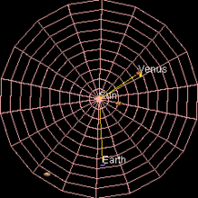
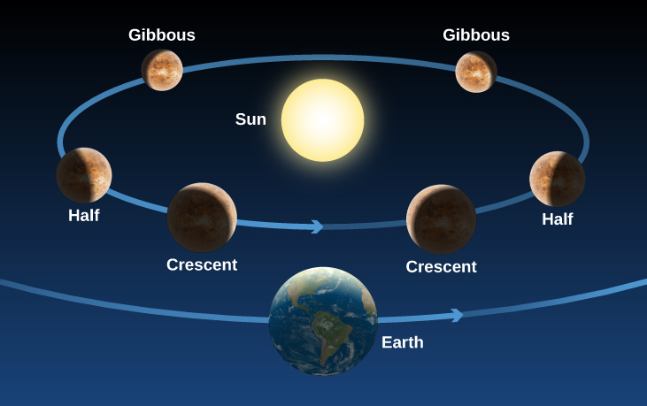
Inner planets: Venus
Venus is the second planet from the Sun, orbiting it every 224.7 Earth days.
It has the longest rotation period (243 days) of any planet in the Solar System
Rotates in the opposite direction to most other planets (so the Sun would rise in the west and set in the east)
Perhaps due to large asteroid collision?
See Venus phases, just like with the Moon

Slide 4
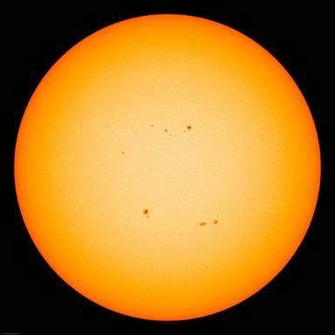

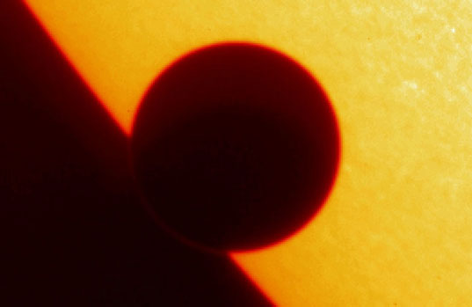
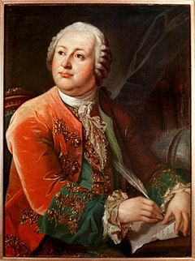
Historical importance – solar disk transit
Observing Venus transit in front of the Sun’s disk on June 6th, 1761, Mihailo Lomonosov discovered that it had atmosphere just like Earth does.
First observation of atmosphere around another world

Slide 5
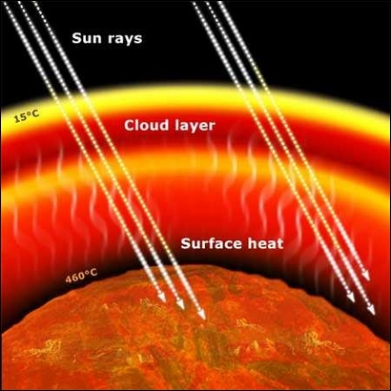
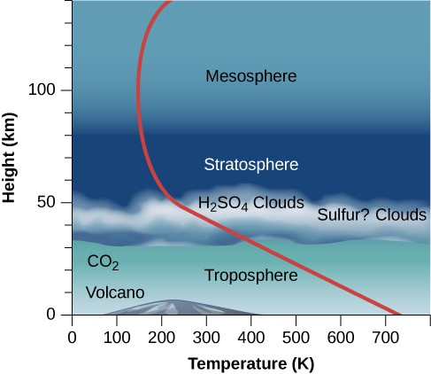
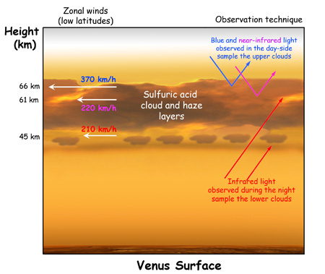
Inner planets: Venus
Densest atmosphere of the four terrestrial planets, consisting of more than 96% carbon dioxide.
The atmospheric pressure at the planet's surface is 92 times that of Earth, or roughly the pressure found 900 m (3,000 ft) underwater on Earth.
Venus is by far the hottest planet in the Solar System, with a mean surface temperature of 735 K (462 °C; 863 °F), even though Mercury is closer to the Sun. Venus is shrouded by an opaque layer of highly reflective clouds of sulfuric acid, preventing its surface from being seen from space in visible light.
Similar day and night temperatures due to strong winds

Slide 6
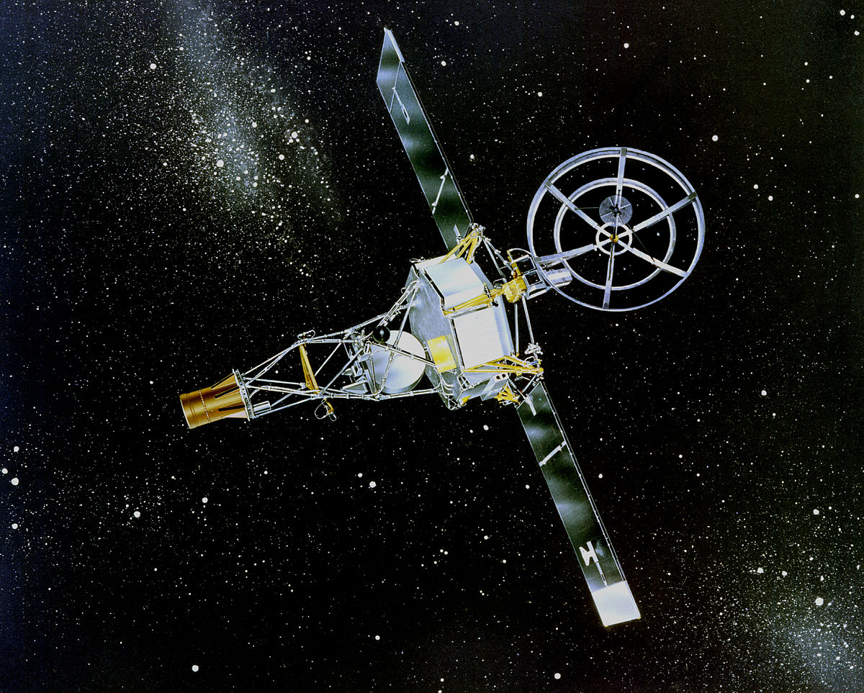
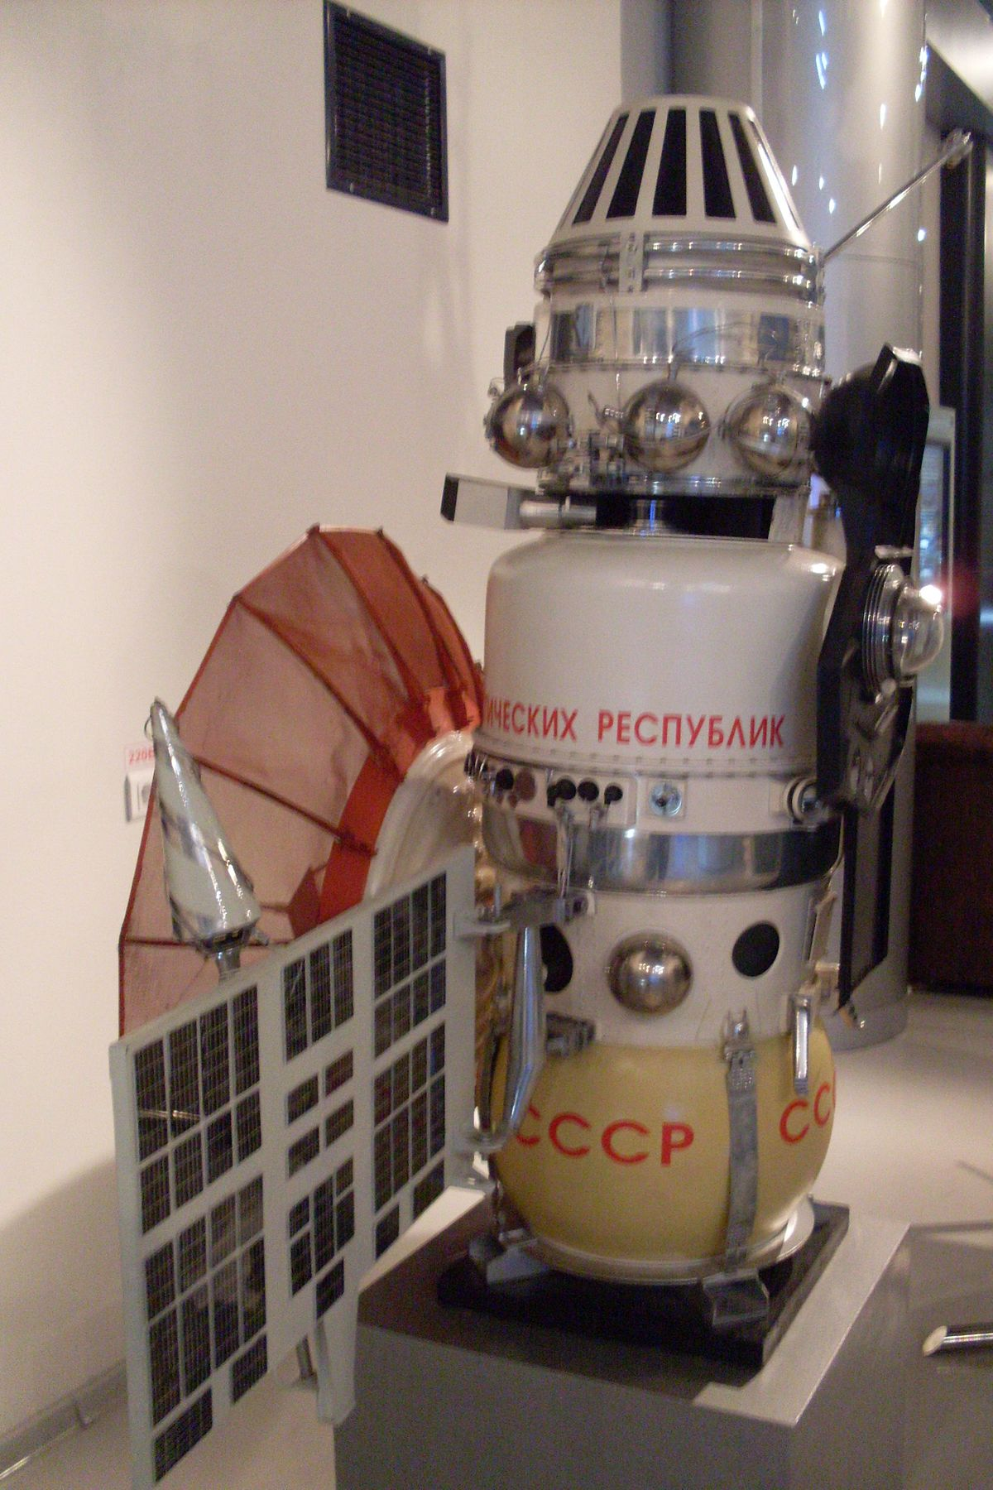
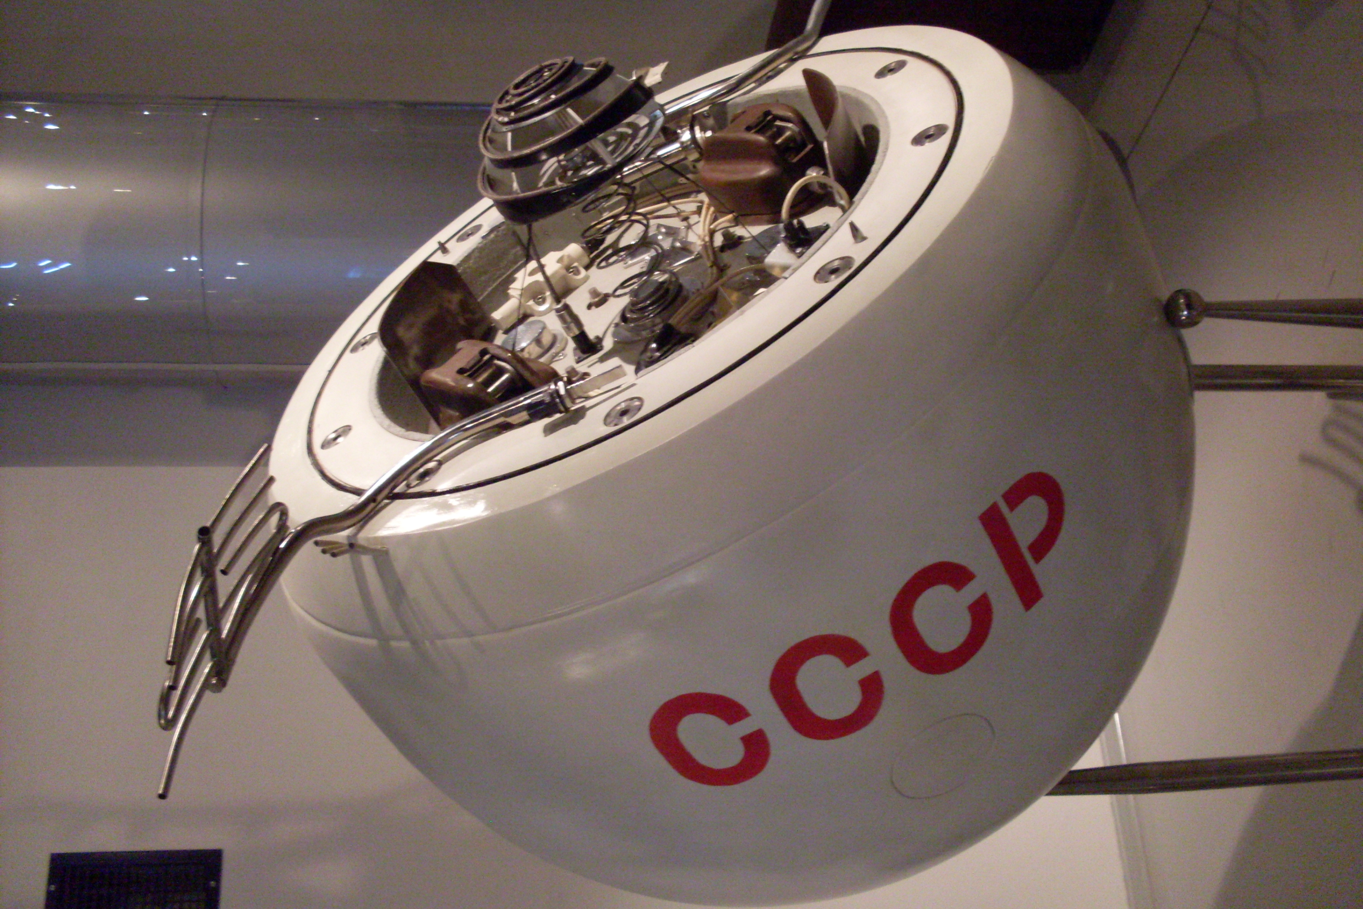
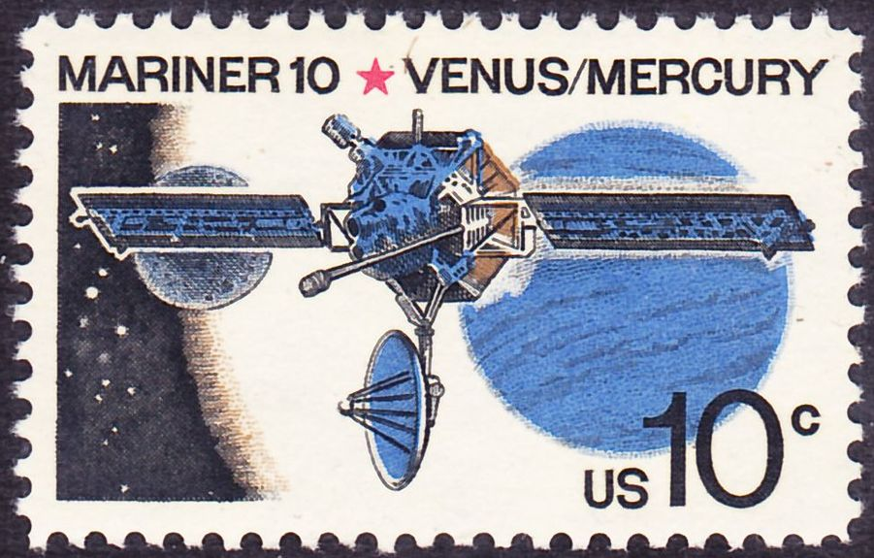
Inner planets: Venus - exploration
The United States' exploration of Venus had its first success with the Mariner 2 mission on 14 December 1962, becoming the world's first successful interplanetary mission, passing 34,833 km (21,644 mi) above the surface of Venus - flyby, and gathering atmosphere data
18 October 1967, the Soviet Venera 4 successfully entered the atmosphere; Venera 4 showed the surface temperature was at almost 500 °C (932 °F), also that the atmosphere is 95% carbon dioxide
Several Mariner and Venera missions in the meanwhile
In 1974, Mariner 10 swung by Venus on its way to Mercury and took ultraviolet photographs of the clouds, revealing the extraordinarily high wind speeds in the Venusian atmosphere.
https://en.wikipedia.org/wiki/List_of_missions_to_Venus
This Photo by Unknown Author is licensed under CC BY-SA

Slide 7
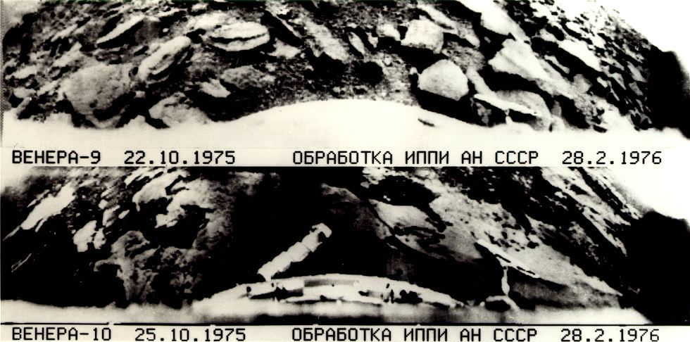
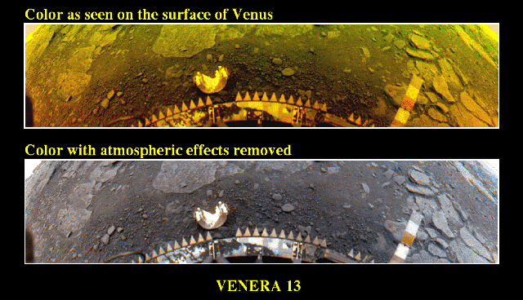
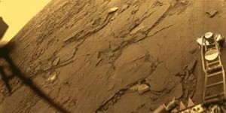
Venus - exploration
In 1975, the Soviet Venera 9 and 10 landers transmitted the first black and white images from the surface of Venus. In 1982 the first color images of the surface were obtained with the Soviet Venera 13 and 14 landers (first recording of sounds from another planet to measure wind speeds).
https://www.youtube.com/watch?v=P3Ife6iBdsU
https://www.youtube.com/watch?v=8jZDW53U8qQ

Slide 8
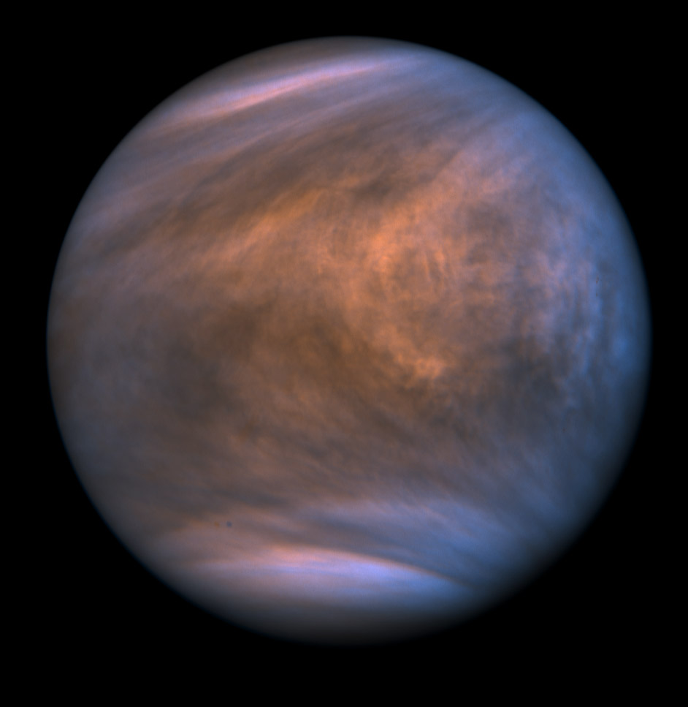
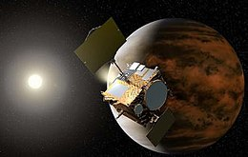
Inner planets: Venus - exploration
NASA obtained additional data in 1978 with the Pioneer Venus project of two separate missions: Pioneer Venus Orbiter and Pioneer Venus Multiprobe. Several other Venus flybys took place in the 1980s and 1990s that increased the understanding of Venus, including Vega 1 (1985), Vega 2 (1985), Galileo (1990), Magellan (1994), Cassini–Huygens (1998), and MESSENGER (2006). Then, Venus Express by the European Space Agency (ESA) entered orbit around Venus in April 2006. Equipped with seven scientific instruments, Venus Express provided unprecedented long-term observation of Venus's atmosphere tillDecember 2014.
2016, Japan's Akatsuki is in a highly elliptical orbit around Venus since 7 Dec 2015 until at least 2 years past 2019 (planned)
Image of Venus with AKATSUKI Ultraviolet Imager (UVI)

Slide 9
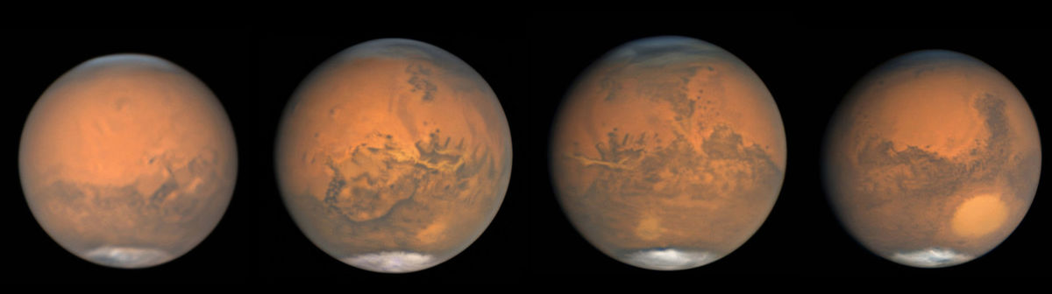
Inner planets: Mars
Mars is the fourth planet from the Sun and the second-smallest planet in the Solar System after Mercury.
Mars carries a name of the Roman god of war and is often referred to as the "Red Planet“ because the reddish iron oxide prevalent on its surface gives it a reddish appearance that is distinctive among the astronomical bodies visible to the naked eye.
Mars is a terrestrial planet with a thin atmosphere, having surface features reminiscent both of the impact craters of the Moon and the valleys, deserts, and polar ice caps of Earth.

Slide 10
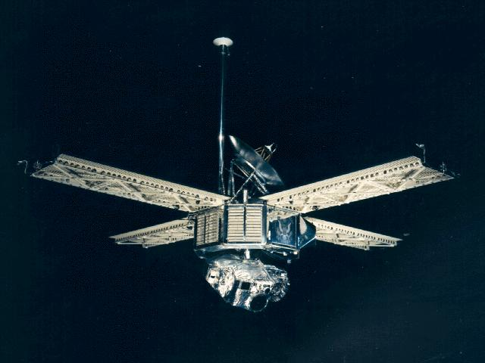
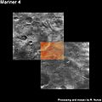
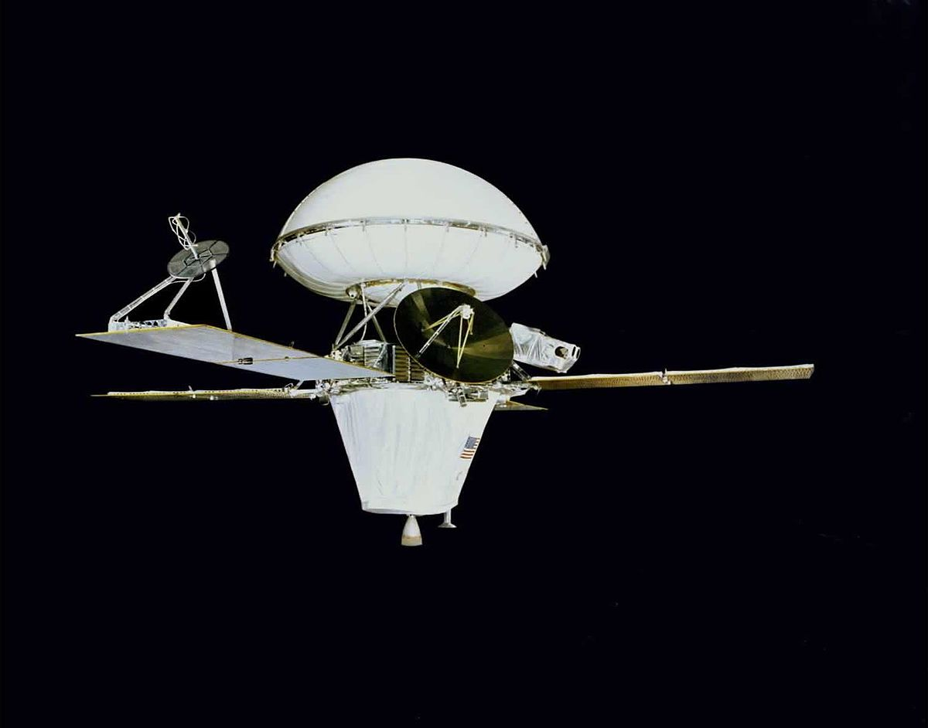
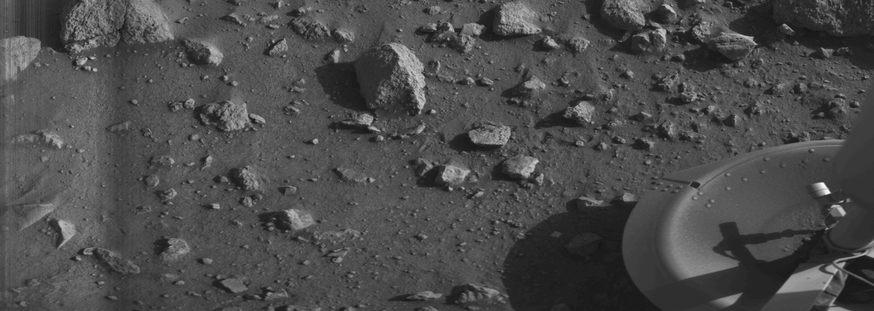
Missions to Mars
https://en.wikipedia.org/wiki/List_of_missions_to_Mars
The first flyby of Mars on 15 July 1965 by the US mission Mariner 4
Many followed with varying success…
Viking 1 – landing on July 20 1976 (US mission)

Slide 11
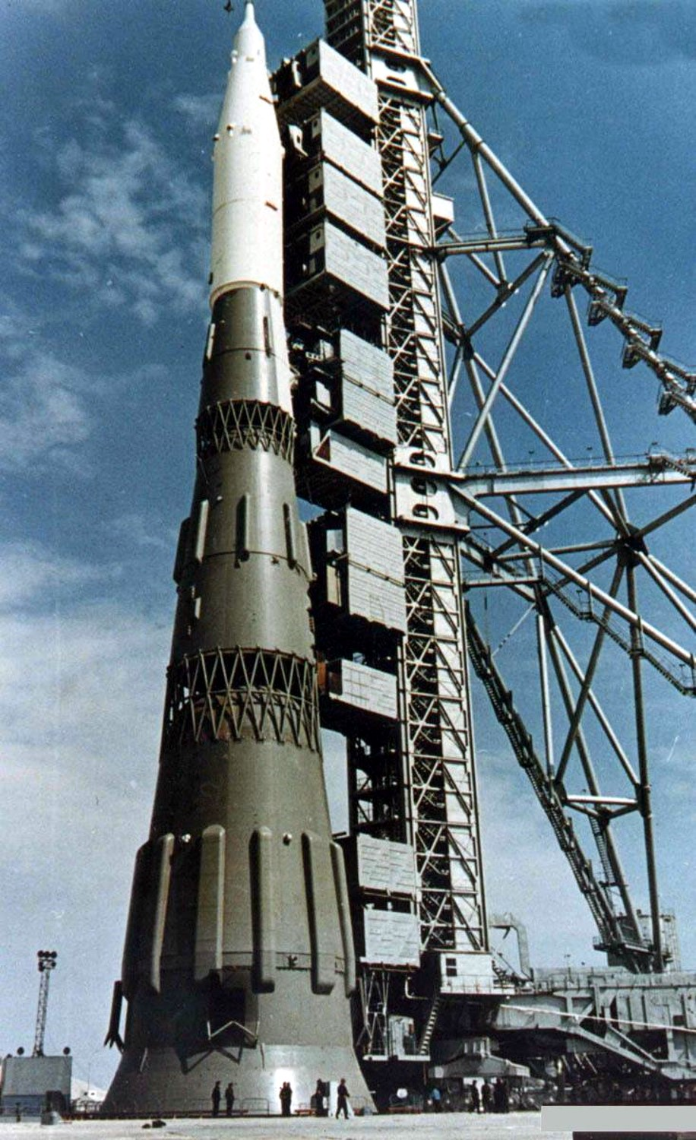
Missions to Mars
USSR tried to prepare manned mission to Moon/Mars
https://en.wikipedia.org/wiki/N1_(rocket)
N1 series rockets - all failures
  N1 1L – full scale dynamic test model, each stage was individually dynamically tested; the full N1 stack was only tested at 1/4 scale.[15]
  N1 2L (1M1) – Facilities Systems Logistic Test and Training Vehicle (FSLT & TV); two first stages painted gray, third stage gray-white and L3 white.[16]
  N1 3L – first launch attempt, engine fire, exploded at 12 km.
  N1 4L – Block A LOX tank developed cracks; never launched, parts from Block A used for other launchers; rest of airframe structure scrapped.[17]
  N1 5L – partially painted gray; first night launch; launch failure destroyed pad 110 East.
  N1 6L – launched from the second pad 110 West, deficient roll control, destroyed after 51s.
  N1 7L – all white, last launch attempt; engine cutoff at 40 kilometres (22 nmi) caused propellant line hammering, rupturing the fuel system.
  N1 8L and 9L – flight ready N1Fs with improved NK-33 engines in Block A, scrapped when the program was canceled.
  N1 10L – uncompleted, scrapped along with 8L and 9L.
Mockup at the Baikonur Cosmodrome in late 1967 as actual launches were top secret

Slide 12
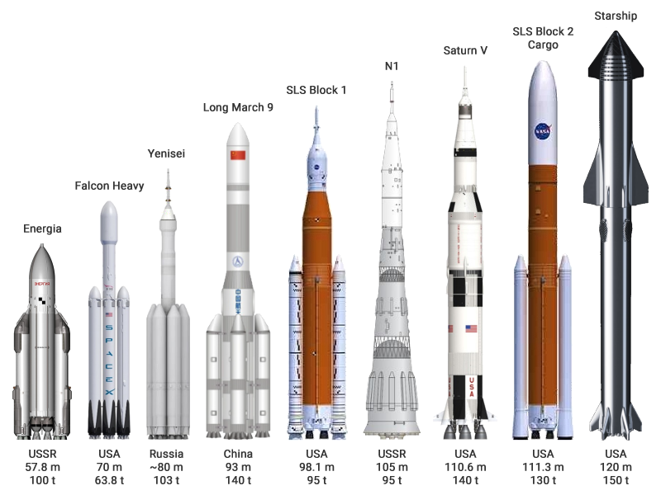
Heavy-lift launch vessels
(past and future)

Slide 13


Any Questions?
Colonizing Mars? Terraforming Venus?

